Slide 1

Alignment ZIP Codes 2022 8
Author andymerriman1 user

Slide 2
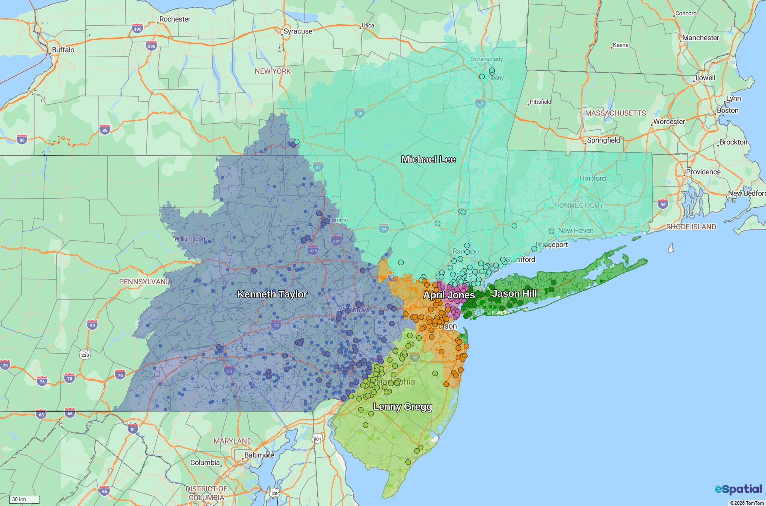
Alignment ZIP Codes 2022 8

Slide 3
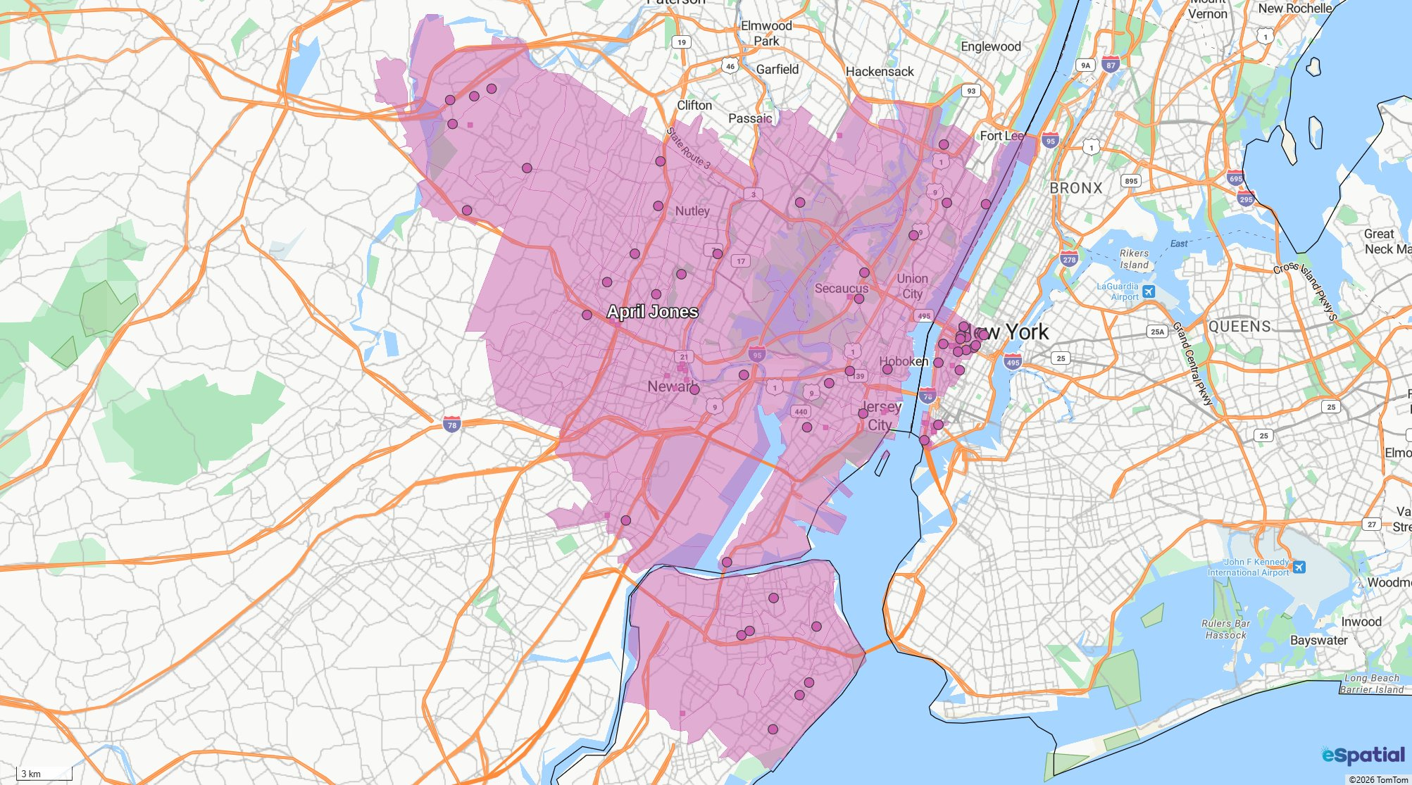
April Jones
Attribute | Value | Attribute | Value
Sales | 441,340 | Count Small Zips Sample | 54

Slide 4
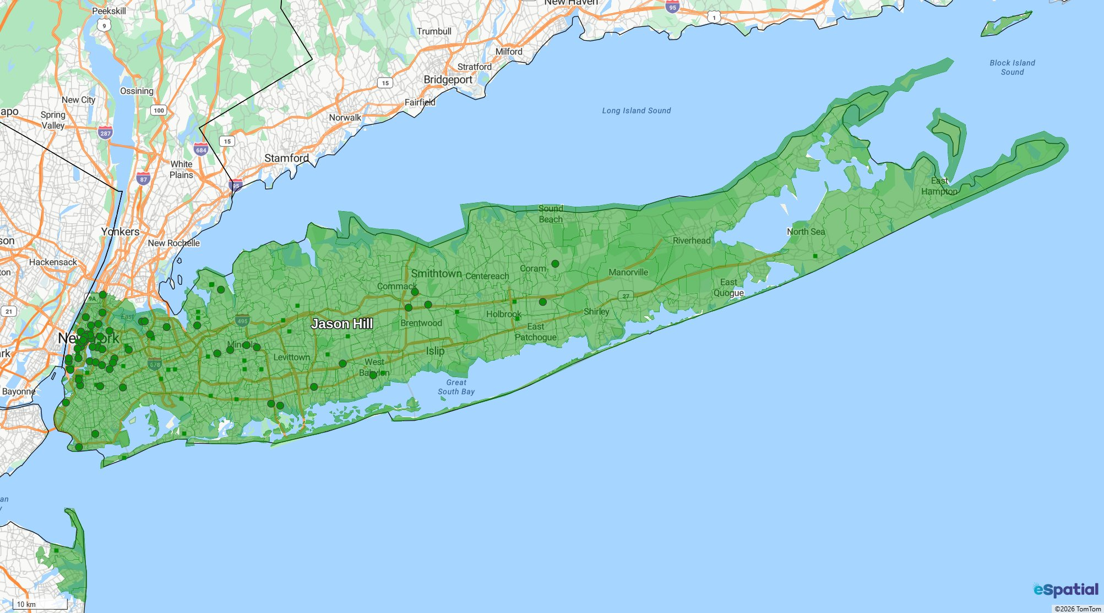
Jason Hill
Attribute | Value | Attribute | Value
Sales | 518,410 | Count Small Zips Sample | 67

Slide 5
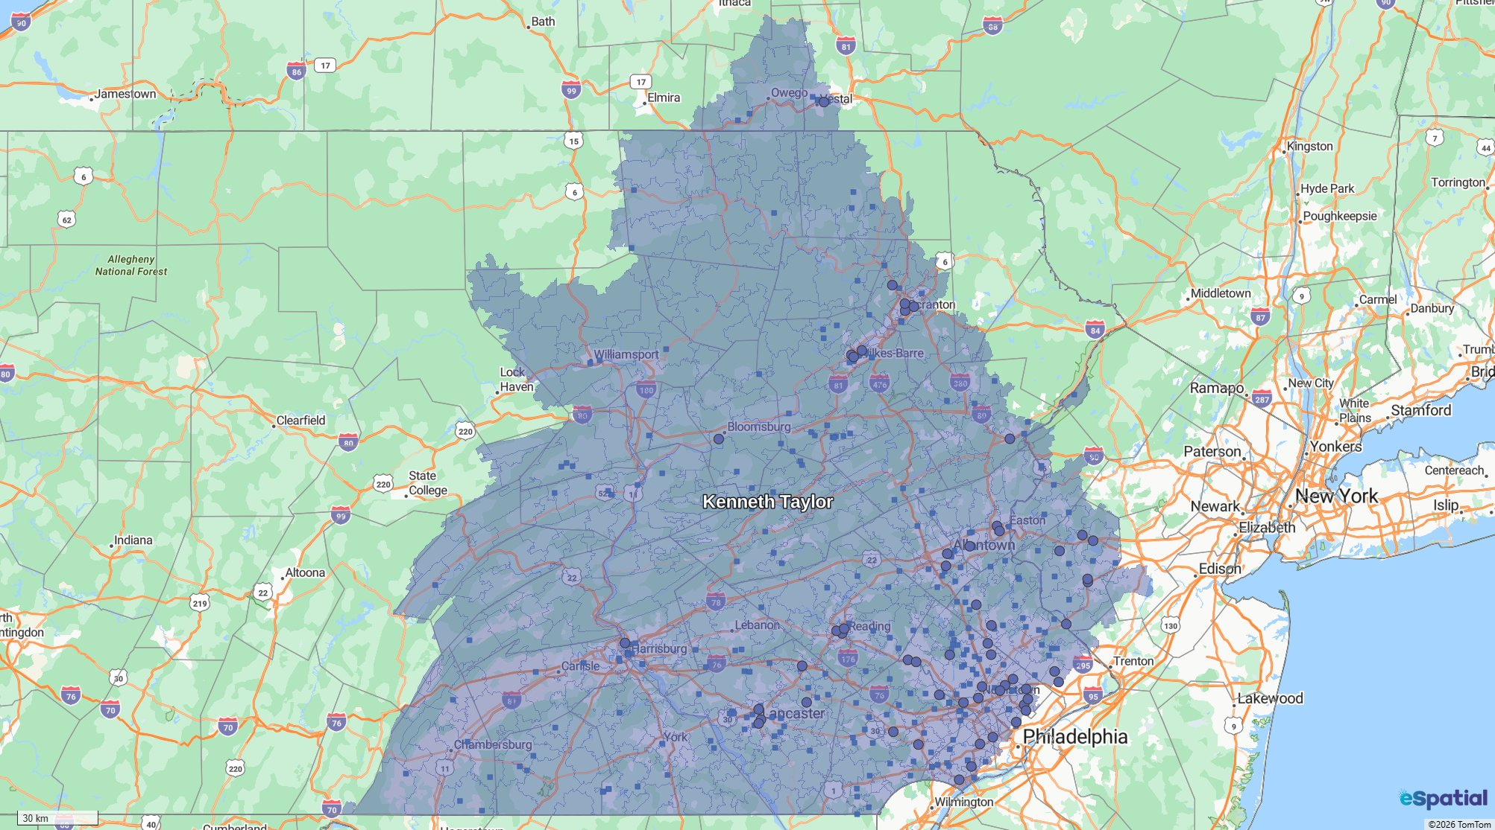
Kenneth Taylor
Attribute | Value | Attribute | Value
Sales | 461,420 | Count Small Zips Sample | 58

Slide 6
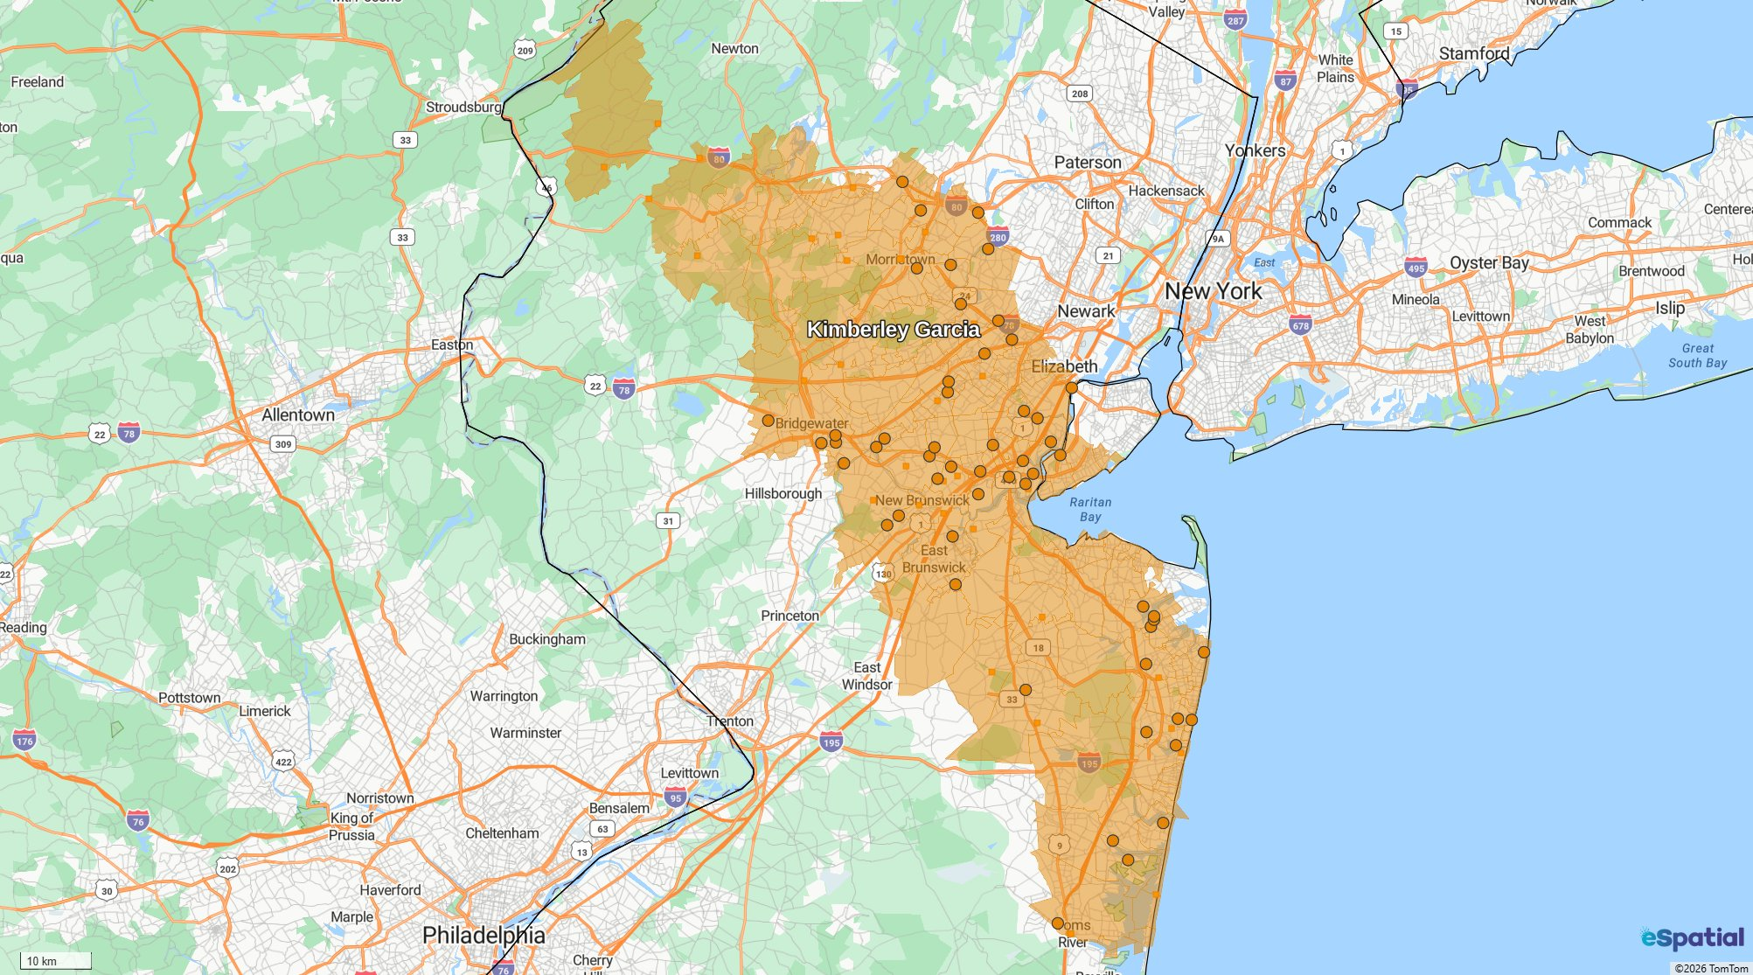
Kimberley Garcia
Attribute | Value | Attribute | Value
Sales | 423,730 | Count Small Zips Sample | 55

Slide 7
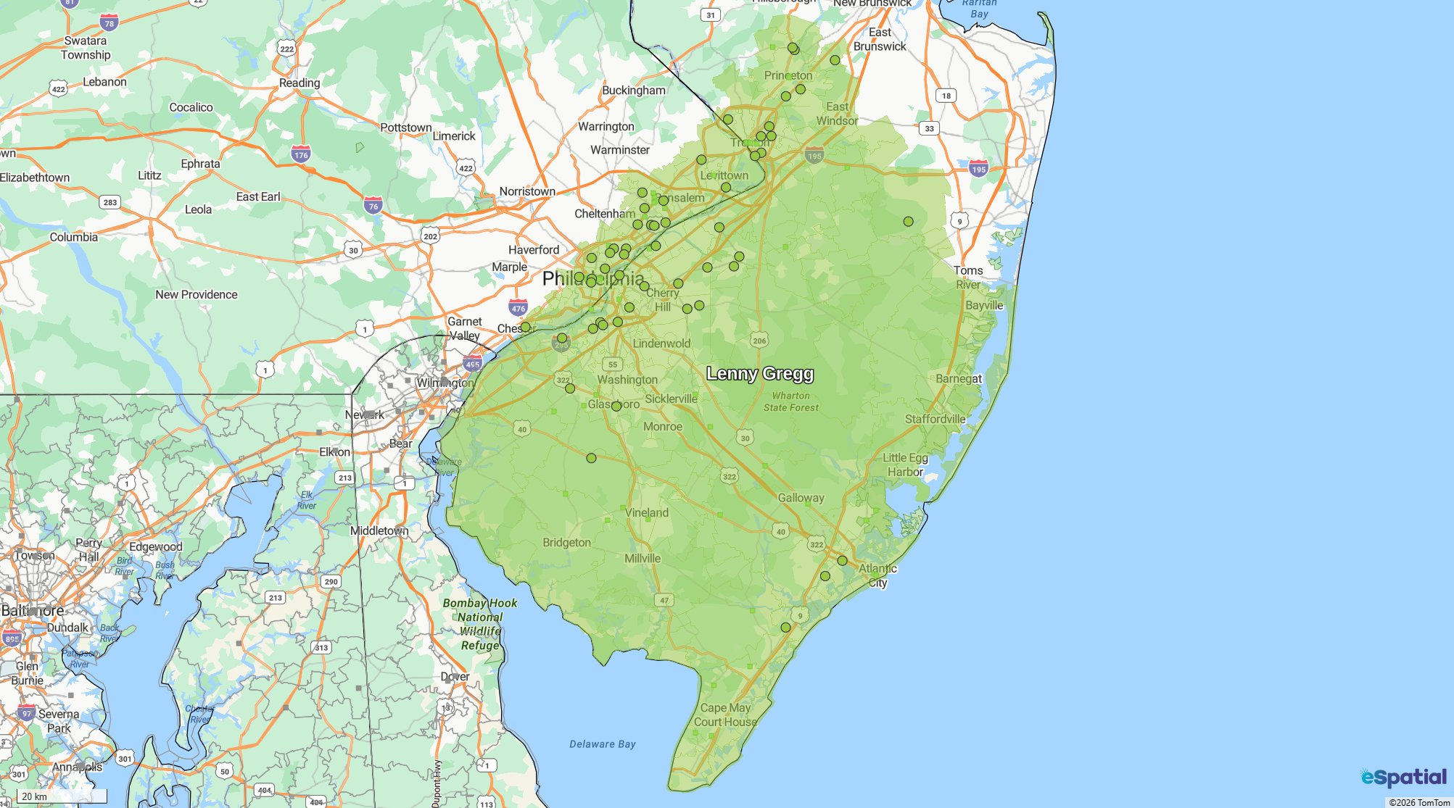
Lenny Gregg
Attribute | Value | Attribute | Value
Sales | 420,080 | Count Small Zips Sample | 56

Slide 8
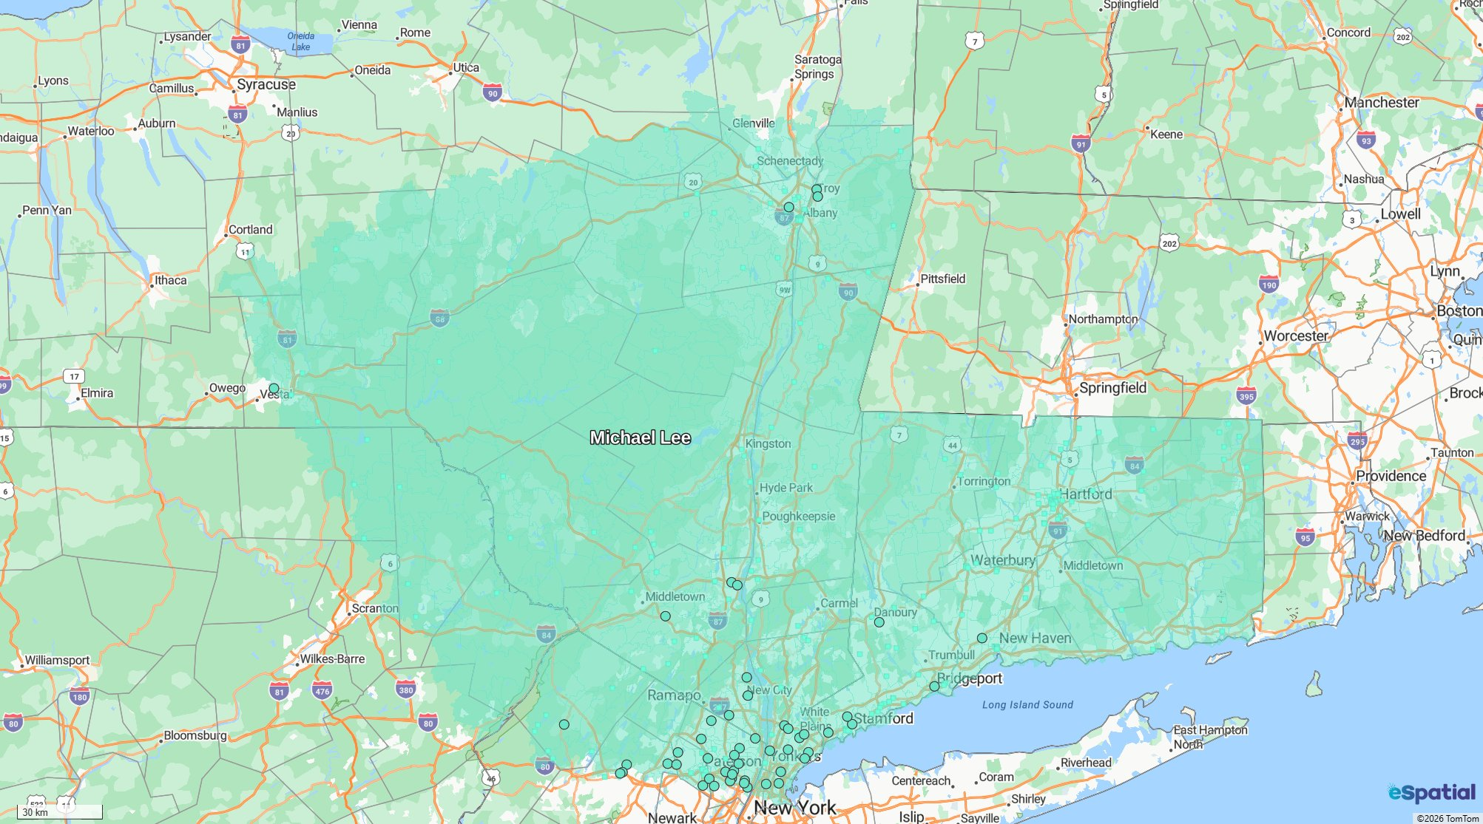
Michael Lee
Attribute | Value | Attribute | Value
Sales | 411,390 | Count Small Zips Sample | 56

